Slide 1
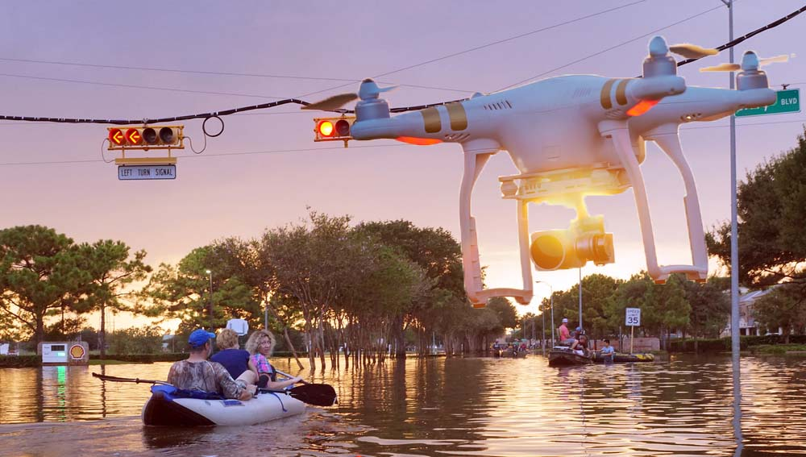

Drones (UAVs) for Disaster Response and Relief Operations
By: Ali Alruzuq, GIS 5038c - Remote Sensing of Environment & GIS 4037 -Digital Image Processing

Slide 2
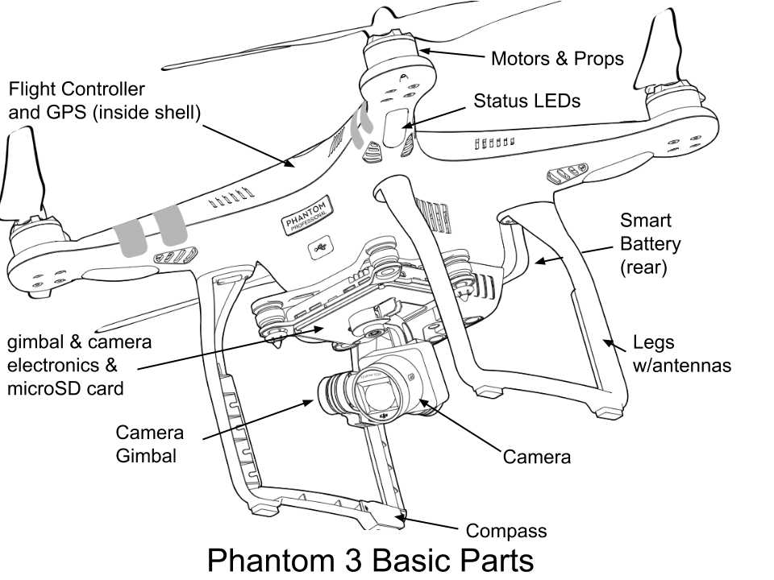
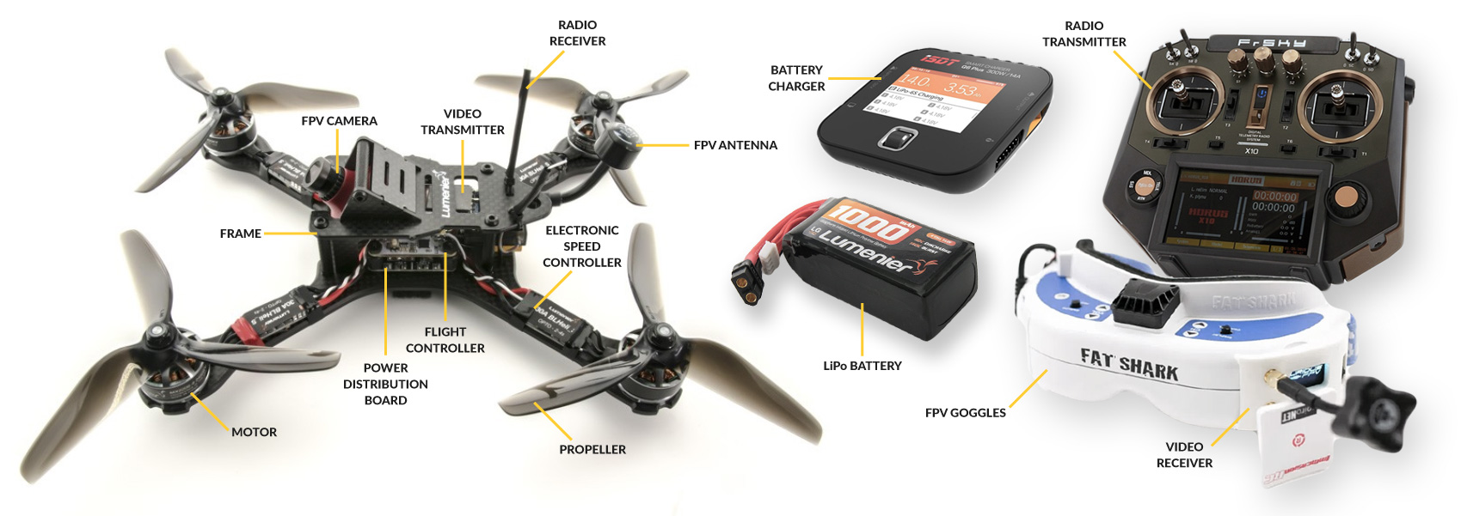
Drone components
What is drone:
An unmanned aerial vehicle, commonly known as a drone, is an aircraft without any human pilot, crew, or passengers on board. UAVs are a component of an unmanned aircraft system, which includes adding a ground-based controller and a system of communications with the UAV.
Software and Products:
DroneDeploy 3D Mapping Solutions. Pix4D Mapper Photogrammetry Software. AutoDesk ReCap Photogrammetry Software.
Parts:

Slide 3
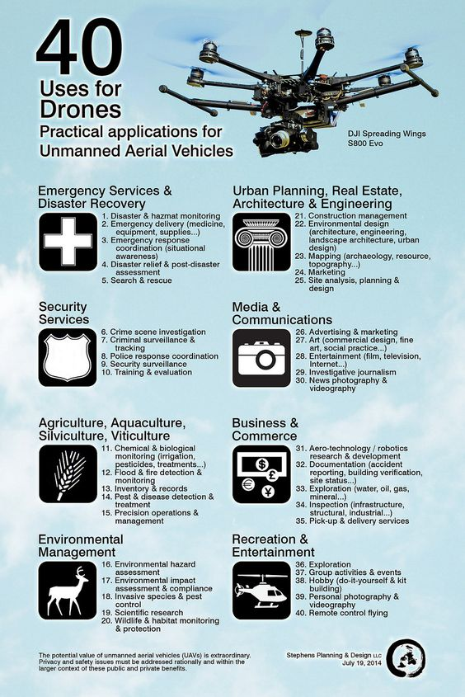
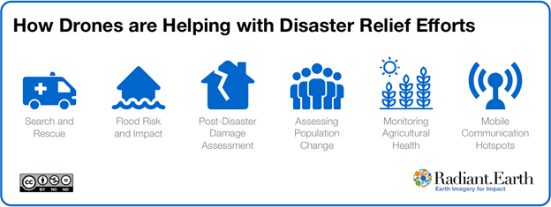
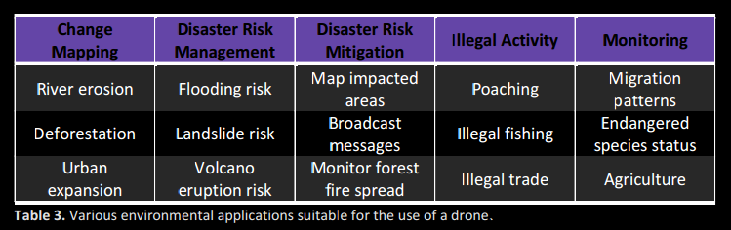
“Eco-drone” applications (per UNEP Global Alert Service, May 2013)

Slide 4
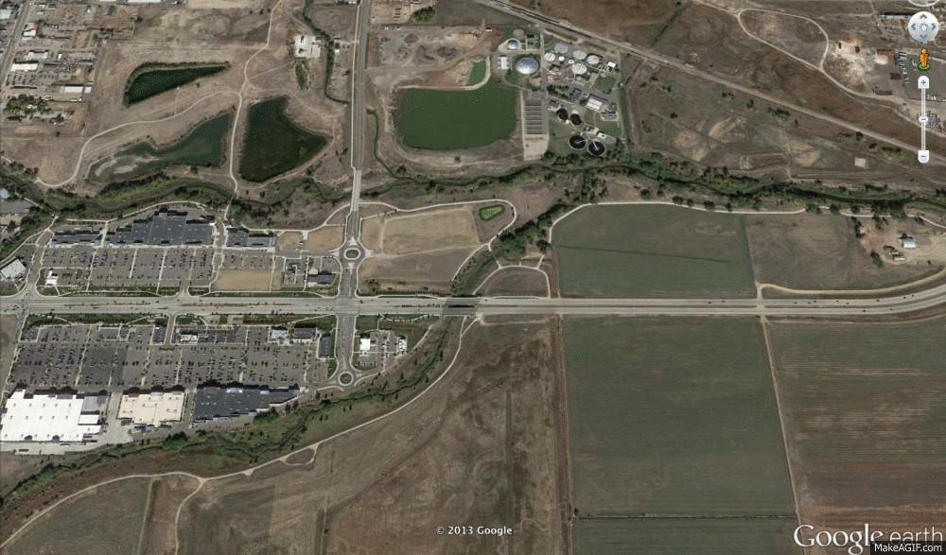
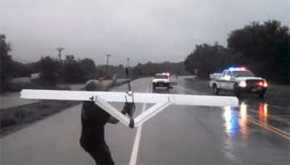
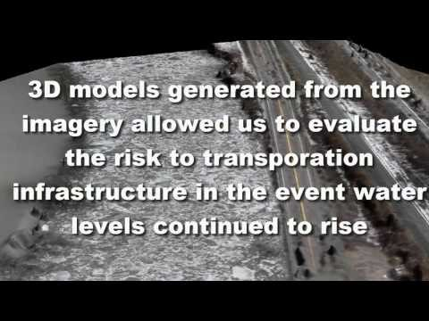
Background/Justification
Floods are observed in many parts globally, from mountains to coastal regions. The gap has been addressed by advancing In (UAV) and digital elevation models (DEM).
UAV applications improved method of making an inundation trace map.
The hazard maps contain results analyzing flood possibility, inundation trace investigation, and an evacuation plan establishment for flooded areas.
Flood mapping in Boulder,
Colorado (Sept. 2013)
Notes:
An example of The reason why are we doing this project and what kind of impact will it make?
Watching vid by University of Vermont UAS Team:
https://www.youtube.com/watch?v=8pI6QtS8Lro&feature=youtu.be

Slide 5
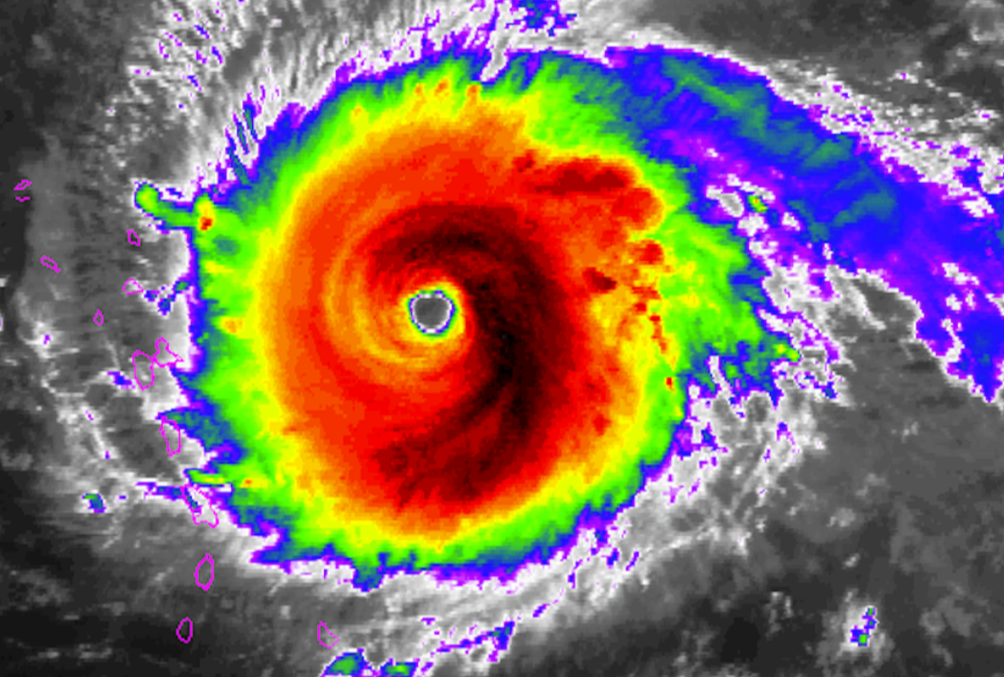
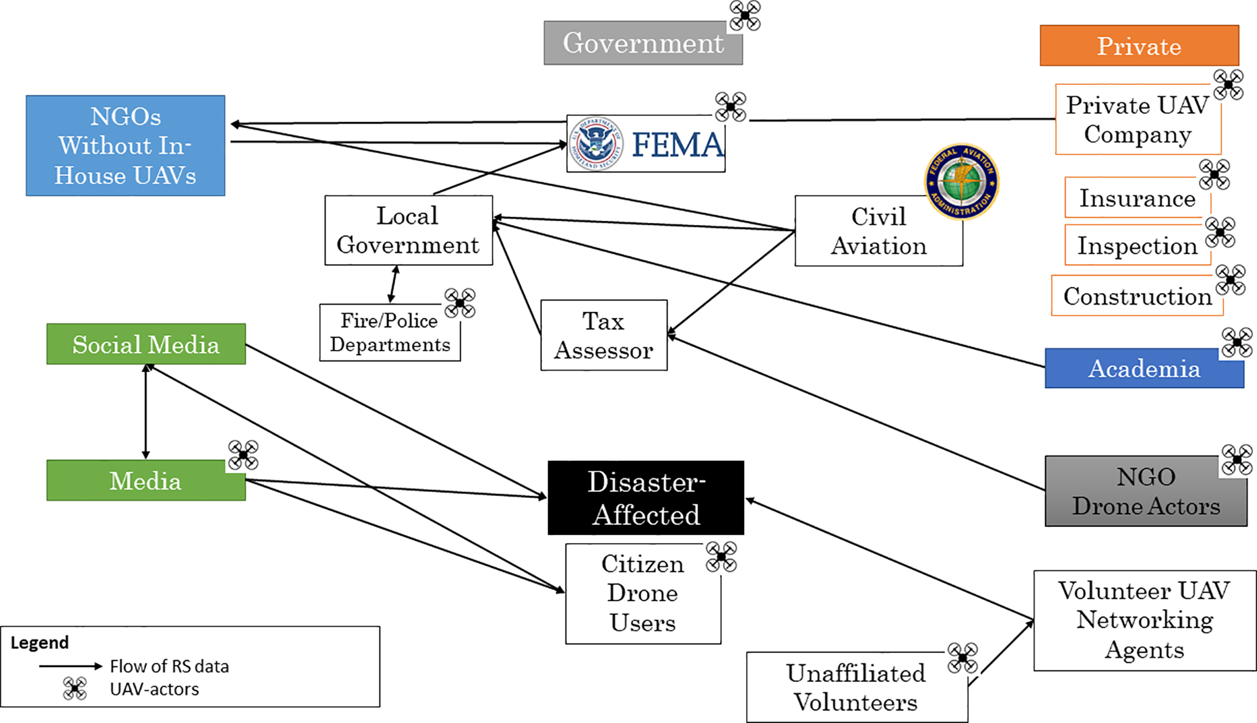
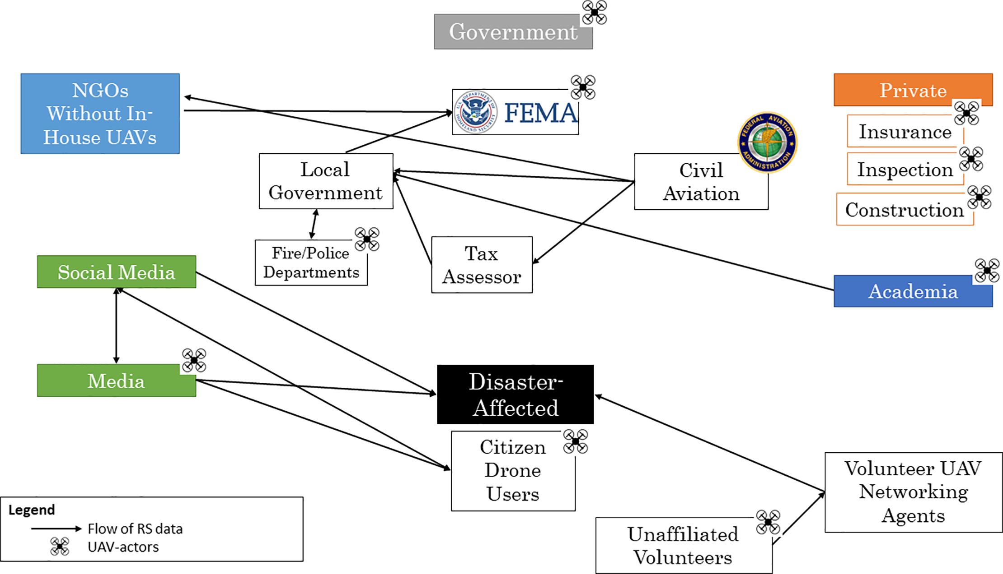
UAS uses in 2 flood events in Texas and Florida, 2017
Ecosystem mapping of UAV-actors and utilizers of UAV-captured, remotely-sensed products after Hurricane Harvey, Texas, 2017 and Irma, Florida, 2017.

Slide 6
Methods
In this work:
1. Provide foundation of understanding on topic and context for my own research.
2. Discover major formative works in the field and ascertain key researchers working on this topic.
3. Identify inconstancies: gaps in research, conflicts in previous studies, open questions left from other research.
4. Recognize need for additional research and questions about how we can use UAS in flooding issues.
5. Find the relationship of works in context of its contribution to the topic and to other works.
6. Place my research within the context of existing literature building a case for why additional study is needed.

Slide 7
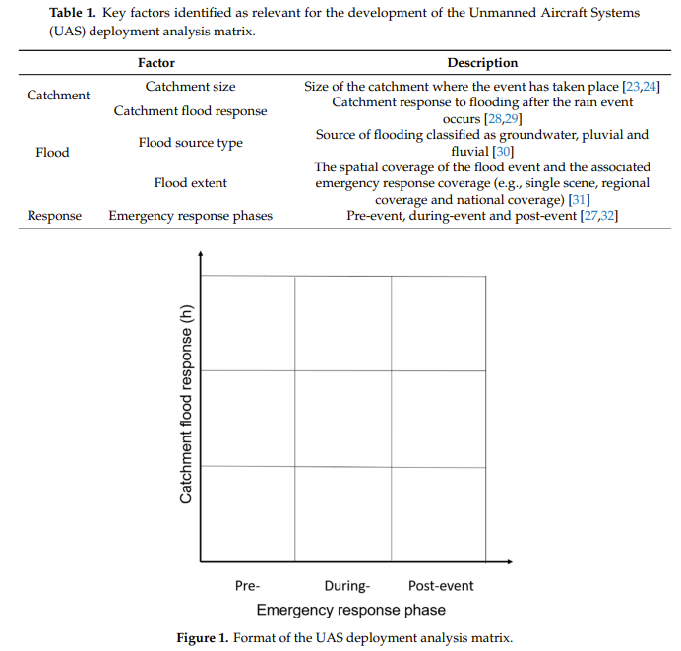
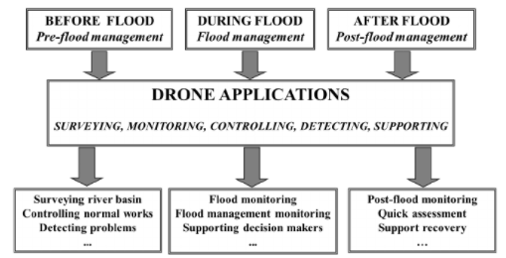
Results
Development of an UAS Deployment Analysis Matrix. “guide for using UAS in flooding”
Before a flood event
During a flood event
After an event

Slide 8
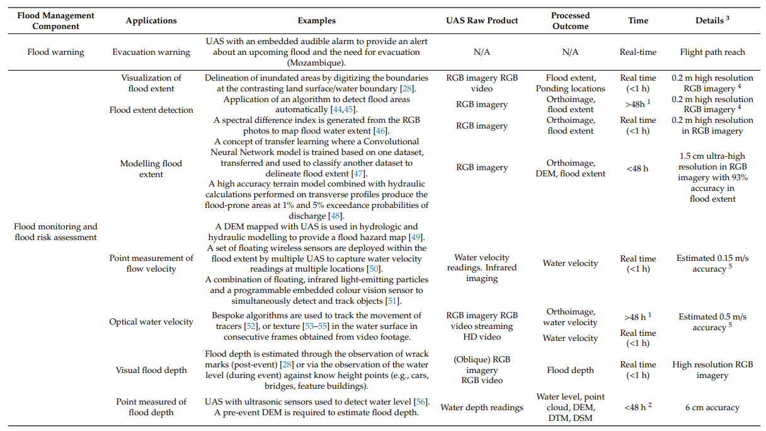
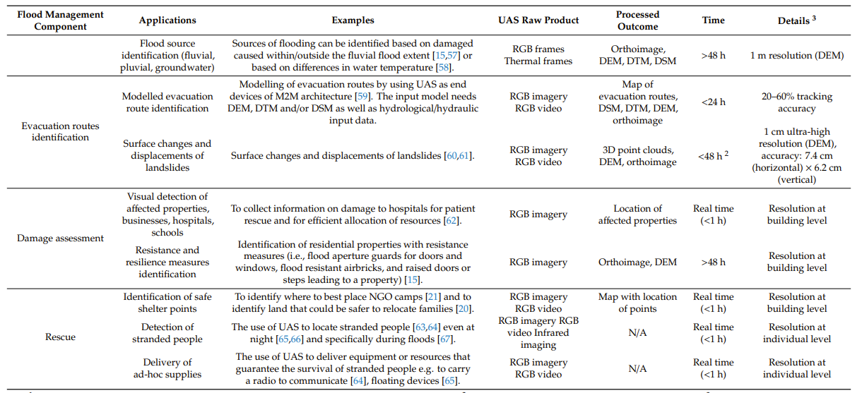
The Potential Use of UAS in Flood Emergency Response:

Slide 9
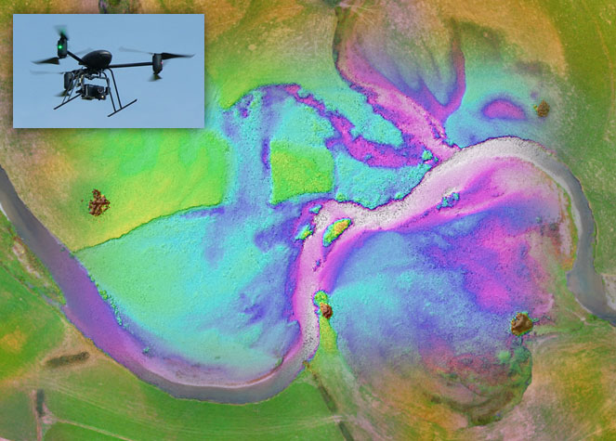
Analysis
Further research should focus on exploring future technological developments of UAS platforms and sensors which would be applied to my study area.
From that point using deferent remotely sensed methods in the floodplain in my study area “Inundation mapping” will have good findings that could be applied to flood management later on.
For example, water indices from a very high resolution data are useful for finding the flood-susceptible areas.
Also, using UAV to assess the infrastructures that play an important role in holding water during the rainfall event such as dams and levee systems.

Slide 10
What else drones can do?
Increase efficiency (Drone collect data 97% faster than manual methods).
Better information (efficiently identify issues manual processes might miss).
Improve asset productivity (identify issues early to make informed decisions).
Avoid hazardous man-hours (conduct surveys without traversing expansive terrain).
Store, track & distribute data (leverage your data across a global team and AI training models).
Notes:
https://youtu.be/ORuwCTqX0fY

Slide 11
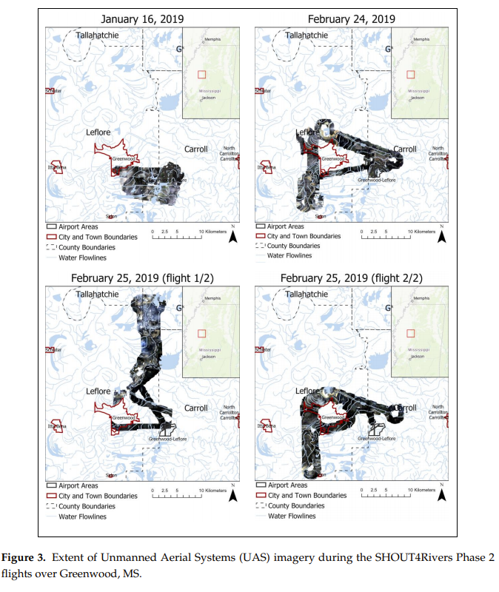
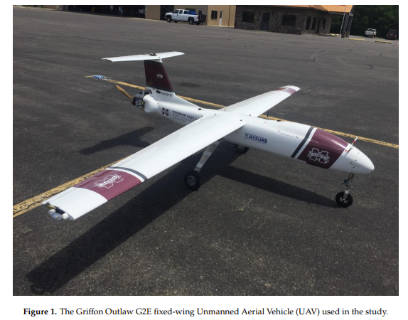
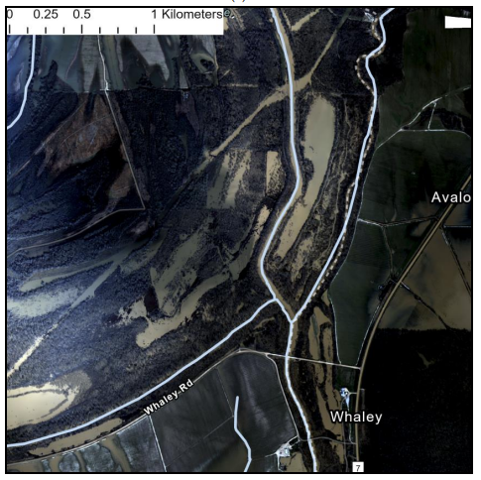
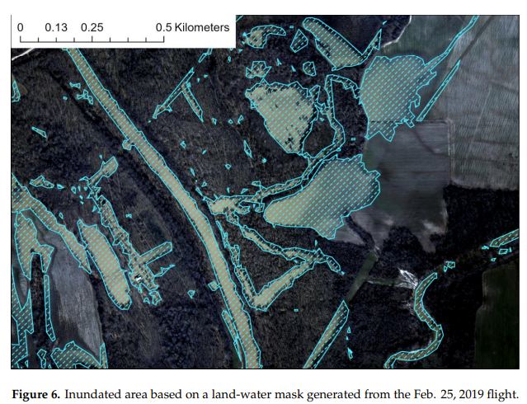
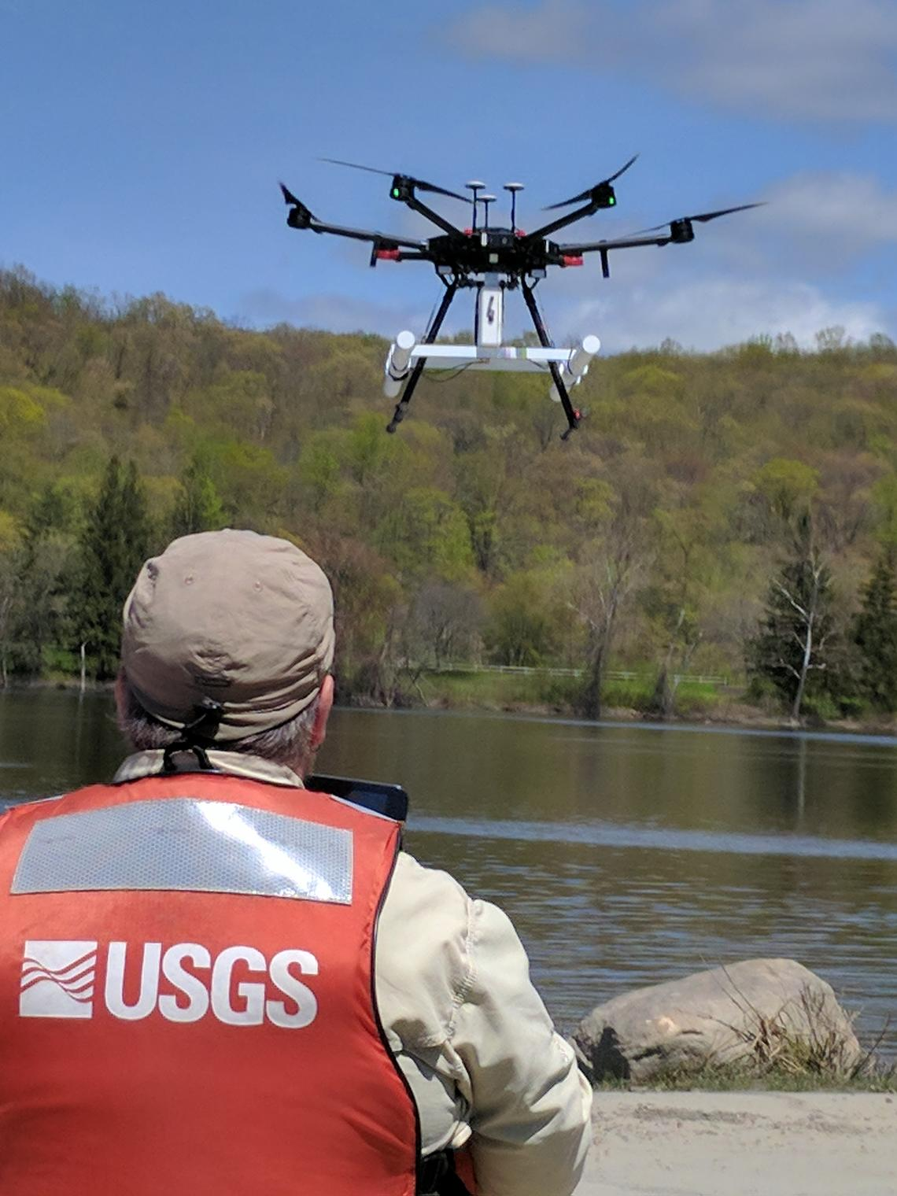
Discussion
In the work we have discuss many approaches that used drone in flooding such as:
UAV-derived DEMs could be an excellent alternative to the LiDAR DEM for small basin flood mapping, thereby compromising between cost and accuracy to the freely available DEM (Tamminga et al., 2015).
Two-dimensional hydrodynamic modeling for risk assessment of urban floods using UAV. The researchers focused on a potential flash flood risk identified in a downstream part of a stream that lost its natural bed because of human interference (Yalcin, 2018)
Hydrologic flood impacts on a microscale level using UAV (Dyer et al., 2020)
Processing to the decision making
Notes:
The interesting points from the work.

Slide 12
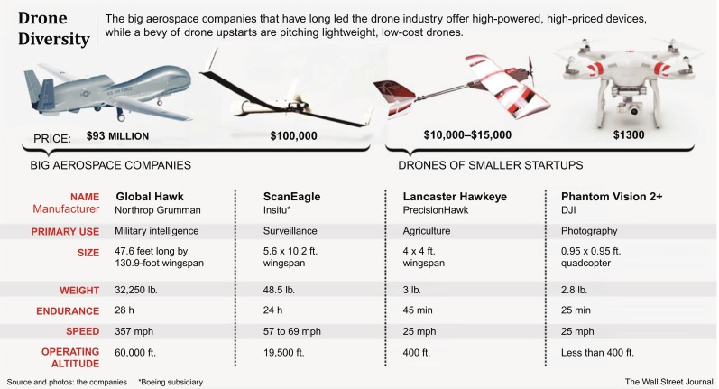
Drone Diversity
Notes:
Drone diversity illustration, showing different types of drones, ranging from ~$1000 worthy consumer ones to military drones worth millions of dollars.

Slide 13
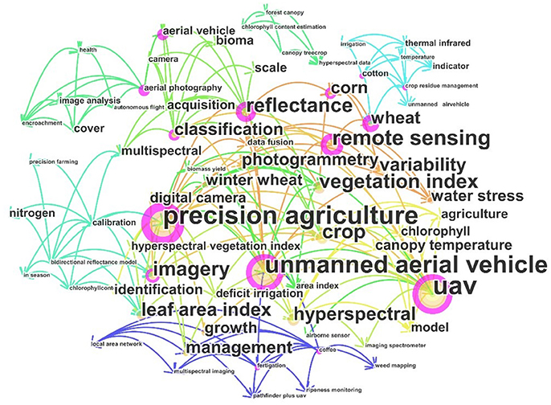
Drones Applications uses in the environment
Frequency of keywords usage within total searched articles.
The bigger the font size, the more high frequency of usage, the same as the circle size corresponding to each keyword.
The different color lines just show connections among keywords or searched papers, respectively.

Slide 14
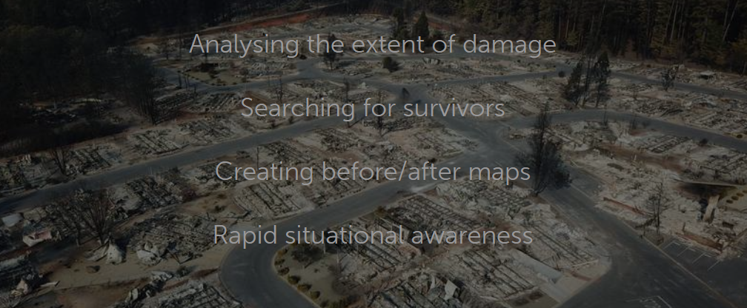
Conclusion
UAV is cost effective tool to anticipate, analyze, and explore different natural hazard such as flooding and the associated natural risks.
UAS also aids in monitoring flood-susceptible areas thus enabling pre- and post-flooding analysis.
To learn more, Join us: American Society for Photogrammetry and Remote Sensing – Student Advisory Council Images. Email me for more information: alialruzuq@ufl.edu

Slide 15
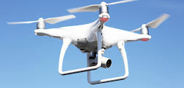


To learn more, Join us: American Society for Photogrammetry and Remote Sensing – Student Advisory Council Images. Email me for more information: alialruzuq@ufl.edu

